Slide 1
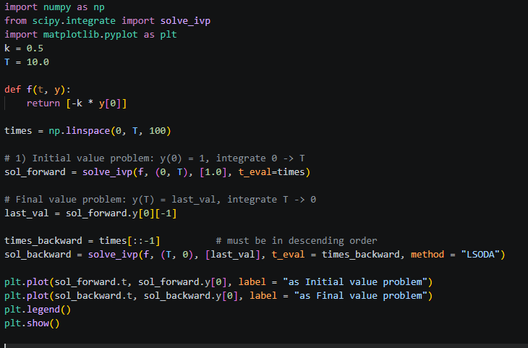
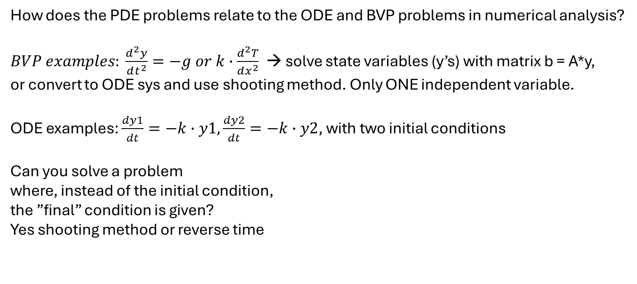
Questions overheard during last class
How does the PDE problems relate to the ODE and BVP problems in numerical analysis?
$BVP examples: \frac{d^{2}y}{dt^{2}}=−g or k∙\frac{d^{2}T}{dx^{2}}$ → solve state variables (y’s) with matrix b = A*y,
or convert to ODE sys and use shooting method. Only ONE independent variable.
ODE examples: $\frac{dy1}{dt}=−k∙y1,\frac{dy2}{dt}=−k∙y2$, with two initial conditions
Can you solve a problem
where, instead of the initial condition,
the ”final” condition is given?
Yes shooting method or reverse time

Slide 2
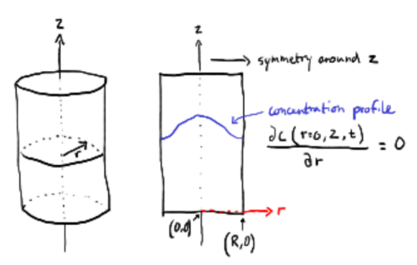

Neumann BC is not only for closed/insulated ends
Symmetry problems
Open flow problems
Advection + diffusion problem (two BCs required)
0
L
”Nothing happens” after domain ends. We turn ”off” diffusion
$$−D\frac{∂C_{(t, x=L)}}{∂x}=0$$

Slide 3
Solutions from last time
2A) diffusion of oxygen through a cell: Dirichlet + Dirichlet
2B) Drug release in muscle tissue: Neumann + Neumann
2C) Heating of metal rod: Dirichlet (left) + Neumann (right)
2D) Cooling of sphere: Neumann (inside sphere) + Robin (edge of sphere)

